Slide 1
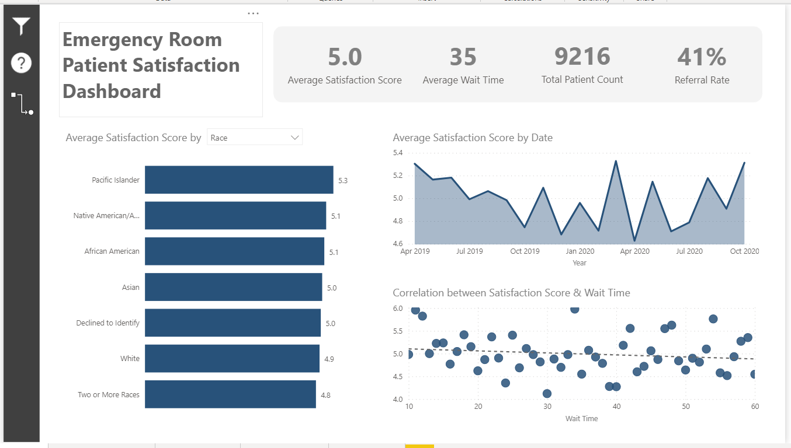
Click here for more filter options
Drill up/down to see the data by different date hierarchies (e.g. year, month, quarter).
Click here to analyze the root cause using the AI driven decomposition tree
Click here to choose a dimension for the bar chart
Click each circle to filter other visuals
Click a bar to filter other visuals. Right click to drill through to see patients’ details

